Slide 1

Hadoop and Spark Big Data Processing
Hira Nisar
MSDSF23M004
Notes:
Hadoop and Spark, two fundamental technologies in the field of big data analytics.

Slide 2

90% of world’s data is generated in just last 2 years
Data Data Everywhere!
In early 2000, the amount of data being generated exploded exponentially!!
Due to the use of Social media, Organizations found themselves struggling with this massive amount of data
Which became very hard to process
Notes:
Its interesting to know that 90 percent of the worlds’ data is generated in the last 2 years and the growth has been exponential due to vast usage of social media apps and it became very hard to process

Slide 3
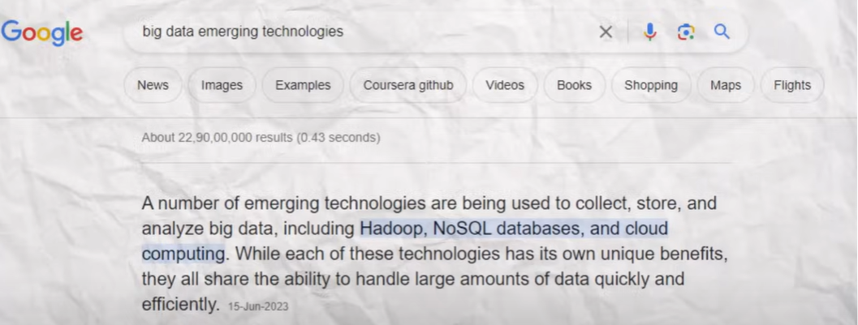
To address this the concept of big data emerged.
Big Data
Big data refers to extremely huge amount of data that is very difficult to store and process
Organizations around the globe wanted to process this huge amount of data to get important insights from it.
Notes:
To address this, the concept of big data emerged , which refers to a very huge amount of data
Now, big organizations around the globe wanted to process this Big Data to gain insights.

Slide 4

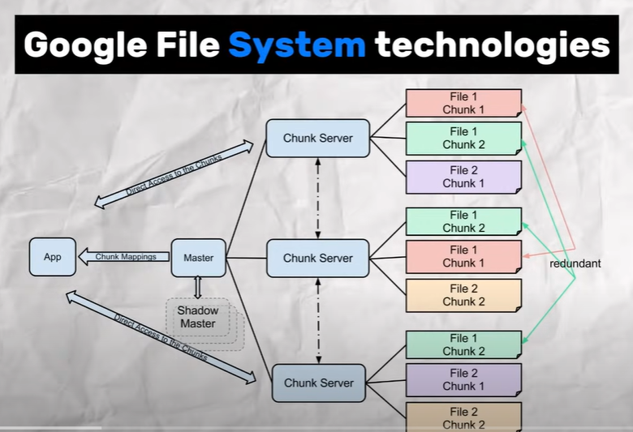
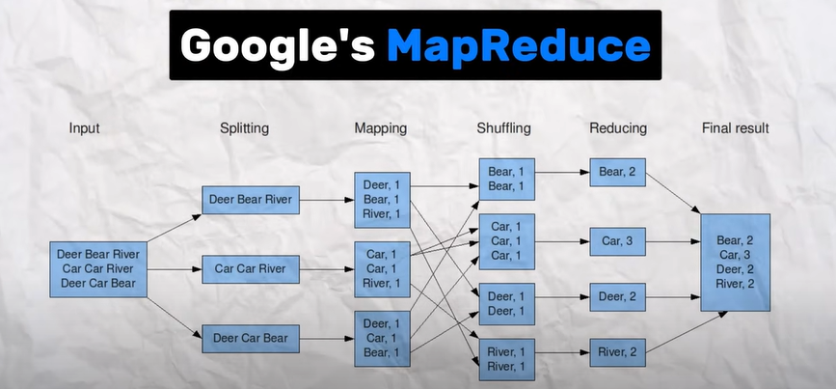
In 2006 a group of engineers from Yahoo developed a software Framework called Hadoop
Hadoop
Inspired by Googles’ MapReduce and GFS, Hadoop introduced “Distributed Processing”
Notes:
In the early 2006 a group of engineers from Yahoo developed a software Framework called Hadoop.
Hadoop was inspired by Googles’ 2 big technologies, GFS, and the other one is Googles’ MapReduce
using these 2 technologies, Hadoop introduced DISTRIBUTED PROCESSING

Slide 5

Instead of relying on a single machine it used multiple computers to get the results
Distributed Processing
Each machine in the cluster will get some part of data to process, they will work simultaneously on this data and at the end will combine the output to get the final results
Notes:
The term Distributed Processing simply means, that
Instead of relying on a single machine we’ll use multiple computers to get the results.
Each machine in the cluster will get some part of data to process, - hence the term Distributed Processing
And they will work simultaneously on this data and at the end will combine the output to get the final results

Slide 6

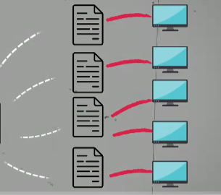

1st component of Hadoop for Data Storage
Hadoop Components (1)
HDFS is a giant storage system for keeping our Big Data safe
It divides our data into multiple chunks and stores all of this data across different computers
Notes:
Hadoop has 2 important components:
One for the data storage and one for data processing…
THE FIRST ONE IS:
Hadoop distributed File system: HDFS
It is a storage system for keeping our Big Data safe very similar to GFS with differences in just the nomenclature.
It divides our data into multiple chunks and stores all of this data across different computers.

Slide 7


2nd Components of Hadoop for Data Processing
Hadoop Components (2)
MapReduce is a super smart way to process all of this data together
It divides our data into multiple chunks and processes all of this data together in a parallel manner
Notes:
The second important component of Hadoop is MapReduce; which is a
Very smart way to Process Big data
Using MapReduce, Hadoop divides the data into multiple chunks and processes all of this data together in a parallel manner

Slide 8
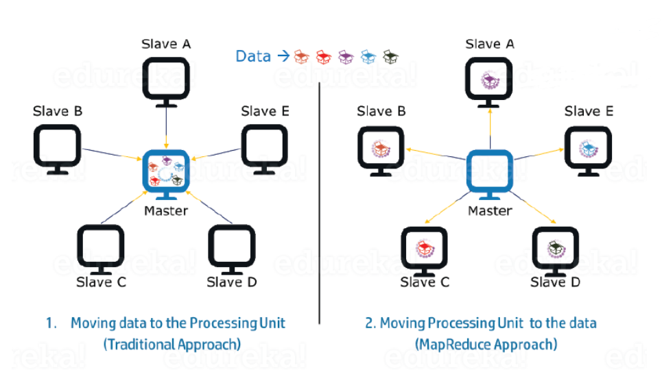
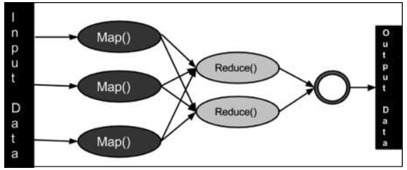
Map Reduce
MapReduce is a processing technique:
Write applications to process huge amounts of data
In parallel
On large clusters of commodity hardware
Reliable manner
MapReduce Tasks:
Map
Reduce
Send the clusters where the data resides
Notes:
MapReduce is a processing technique/ distributed computing model using which we can:
write applications to process huge amounts of data, on large clusters of commodity hardware and that too in a parallel and reliable manner.
The MapReduce algorithm in turn contains two important tasks, namely Map and Reduce.
During a MapReduce job, Hadoop sends the Map and Reduce tasks to the appropriate servers in the cluster.
This paradigm is based on sending the clusters where the data resides because the data is resident on the disk.
The framework manages all the details of data passing.
After completion of the given tasks, the cluster collects and the data and sends it back to the Hadoop server.

Slide 9
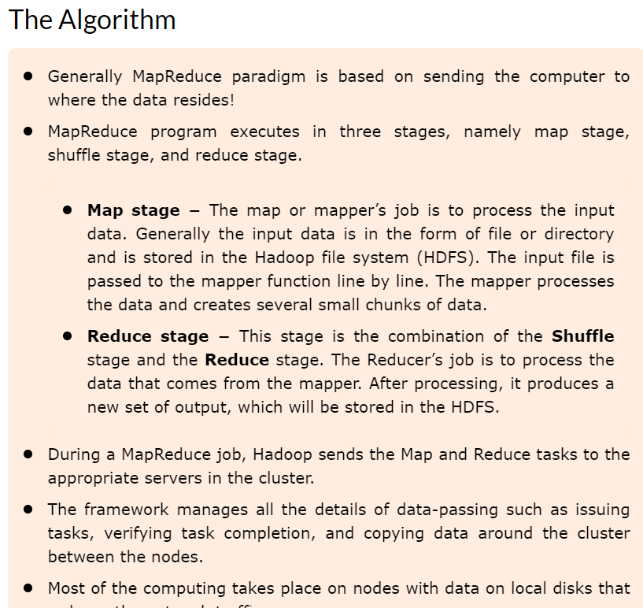
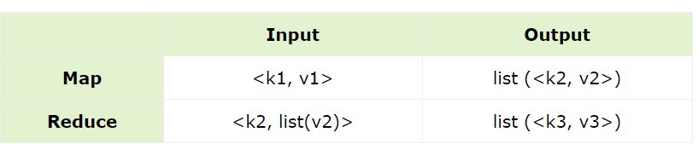
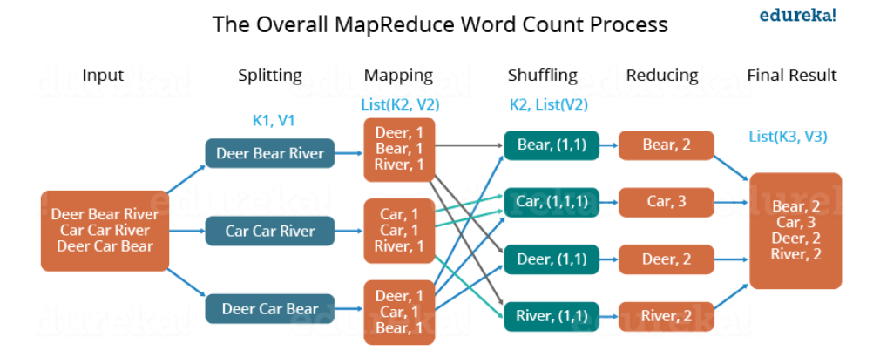
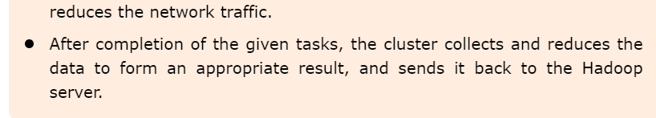
Map Reduce
Notes:
First of all Hadoop sends the machine to the data.
Suppose we have a word count problem where we want to see how many times a word occured in a file.
The input data (Generally a file or directory stored in (HDFS))
is passed to the mapper function line by line. The mapper creates several small chunks of data.
Map takes a set of data and converts it into another set of data, where individual elements are broken down into tuples (key/value pairs).
Secondly, reduce (which is a combination of the Shuffle stage and the Reduce stage)
takes the output from a map as an input and combines those data tuples into a smaller set of tuples.
The Reducer’s job is to process the data that comes from the mapper. After processing, it produces a new set of output, which will be stored in the HDFS.

Slide 10
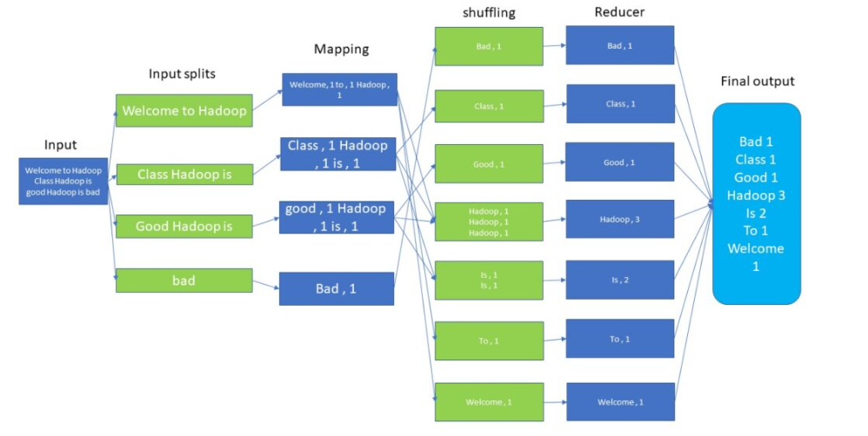
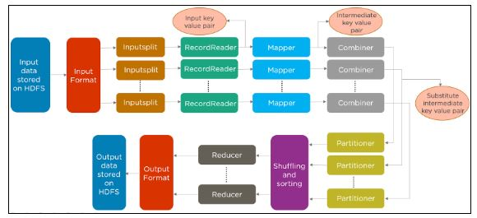
Map Reduce
Batch processing overview
Job Processing overview
Notes:
This is a breakdown of a single batch and a complete Hadoop data processing Job overview,
Where we have input data on HDFS, which is splitted among different nodes and then converted to key value pairs and then sent to mapper functions, this intermediate state called the combiner has intermediate key value pairs spread across different partitions, which are then shuffled and sorted and passed to reducers to get a final output that gets stored to HDFS again.

Slide 11
Map Reduce – Demo
A simple code example where it reads text files and counts how often words occur. The input is text files and the output is text files, each line of which contains a word and the count of how often it occurred, separated by a tab.
Input file:
Text file: Abc.txt
Contents: Cat deer river bear…
Output:
Text file: Xyz.txt
Contents:
World 7
Cat 10

Slide 12
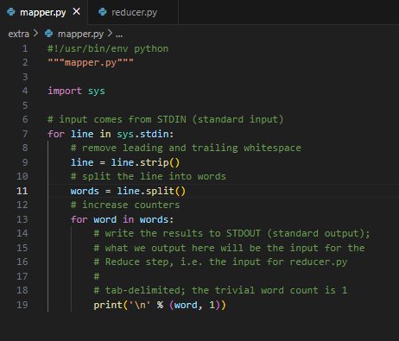
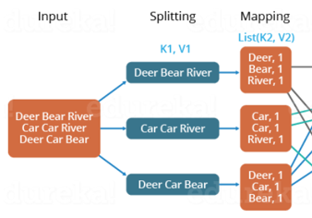
Map Reduce
Removing extra whitespaces
Splitting lines
We need a mapper function that provides a mapping of words and their counts in the splitted lines of the document.
Writing output to command line
Notes:
This is a very basic Mapper function
It takes the file as input, and removes the trailing whitespaces and splits it line by line
And then it is just simply outputting the individual words on the standard output that is our command line or terminal.
Because for this use case, what we need the mapper to do at this point is just give us this as output. So that we have each word as a key and 1 as its value.

Slide 13
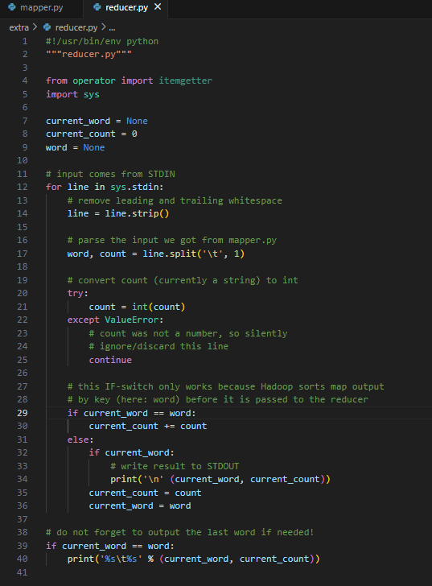
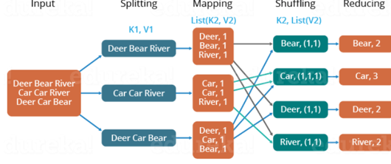
Map Reduce
Reading input from terminal
Splitting
Counting occurrences
We need a reducer function which is a combination of shuffle, sort and reduce operations; that provides a reduced output.
Reducer adding the counts
Notes:
That output then is used as input by the reducer function, that reads it from the terminal and processes it
So for each line it gets from the standard output, it splits it on the basis of tab, and we’ll get a word and a count, and the count is 1 for now.
And then at this stage it simply increments the count and appends to the list the occurrences of each word iteratively. Then reducer just adds the counts for each word and outputs them to the terminal.

Slide 14
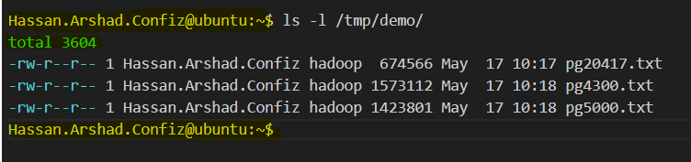
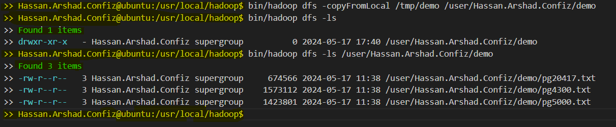
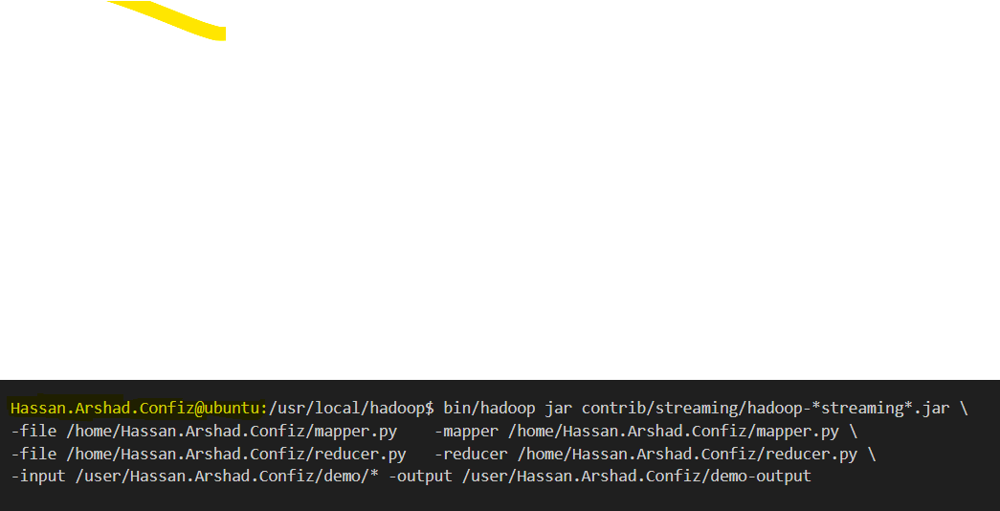
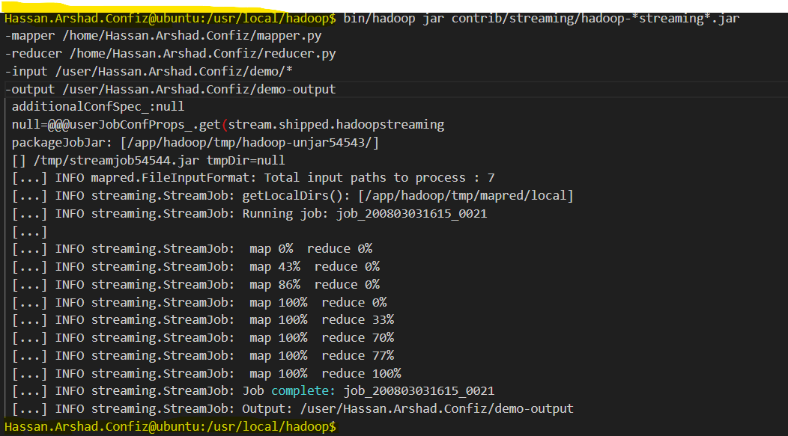
Map Reduce
Downloaded Text Files (3 books) from the internet
Uploaded them to HDFS
Ran a MapReduce Job:
!hadoop jar /usr/lib/hadoop-mapreduce/hadoop-streaming.jar \
-input /path/to/input \
-output /path/to/output \
-mapper mapper.py \
-reducer reducer.py
This is the output of the job (in Terminal)
Notes:
These are now purely the command line operations
As long as the mapper function is running the reducer is idle, since reducer uses the output of mapper as input, and after the mapping is done the reducer starts to function.

Slide 15
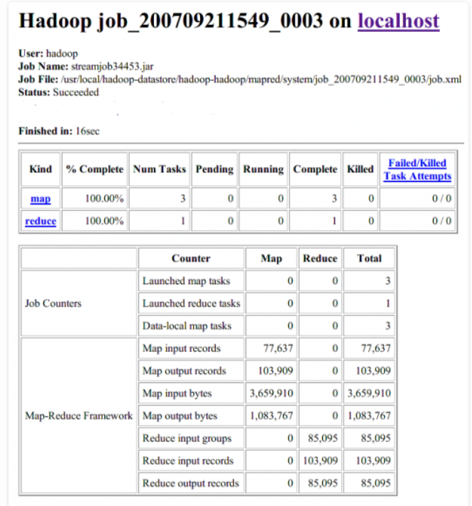
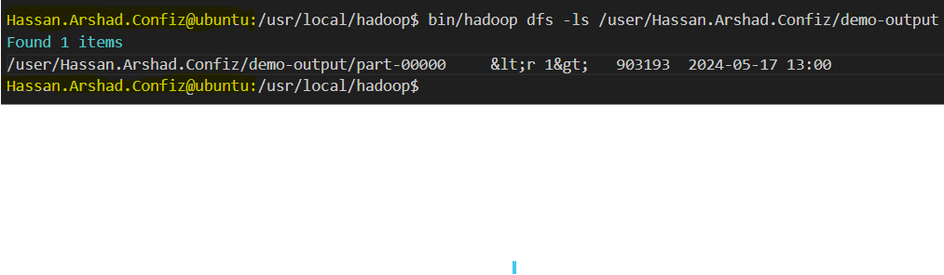
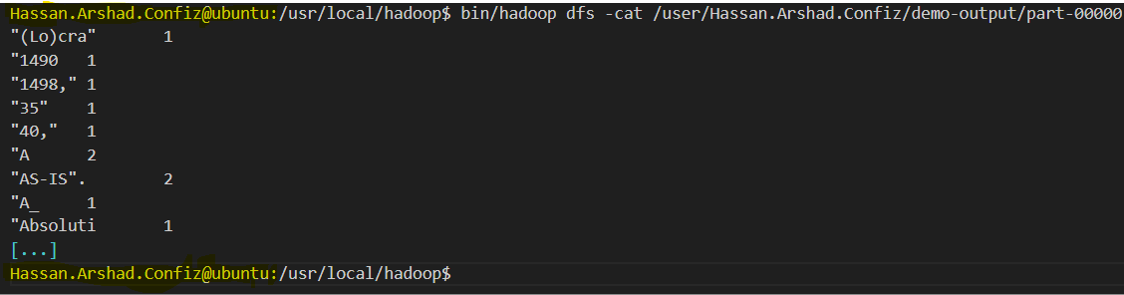
Map Reduce
Checking whether the output was written in HDFS
Output file
Hadoop UI – Localhost
Notes:
Here is the output of our job in UI

Slide 16
Map Reduce
Steps:
Mapper Function
Reducer Function
Downloaded files from internet
Uploaded those on HDFS
Ran MapReduce Job
Output of the job (Terminal)
Notes:
In these minimal steps, MapReduce made such a heavy computation of counting the occurrence of each word in 3 books so easy for us.

Slide 17
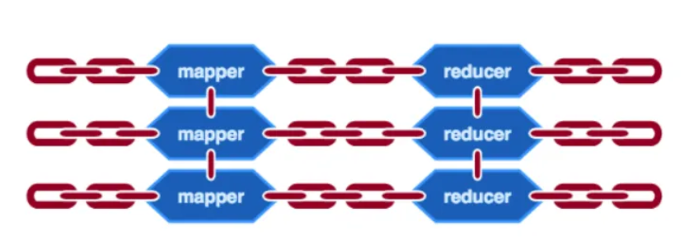
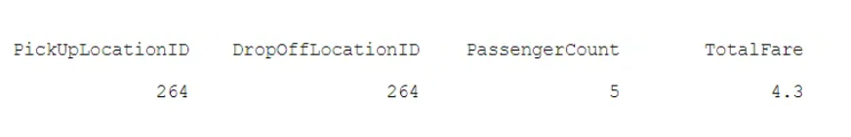
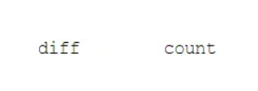
Multiple Map Reduce Jobs
NYC Taxi & Limousine Commission dataset of around 7.6 million rows
Input
Output
Problem:
“diff” is a location ID’s out-degree minus its in-degree. The out-degree of a location is the number of times that location is used for pickup and the in-degree is the number of times it is used for dropoff. Then, “count” is the frequency for a particular “diff”.
Therefore, one way to accomplish this is to have two MapReduce jobs. One is to calculate the “diff” for each location and the other is to turn that output of the first job into “count” as we want above.
Notes:
Chaining of MapReduce Jobs?
This is a comparatively complex
The demo takes NYC Taxi & Limousine Commission dataset of around 7.6 million rows to compute the distribution of degree differences of locations.
Let’s say we want to use MapReduce to obtain the following output of two columns:

Slide 18
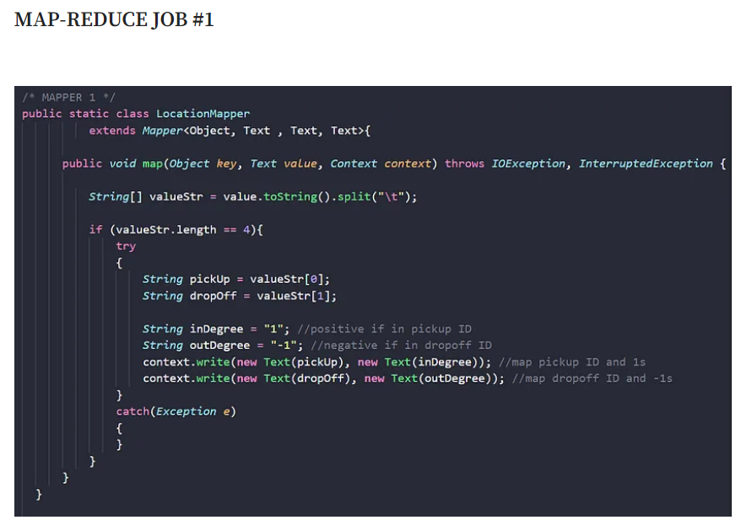
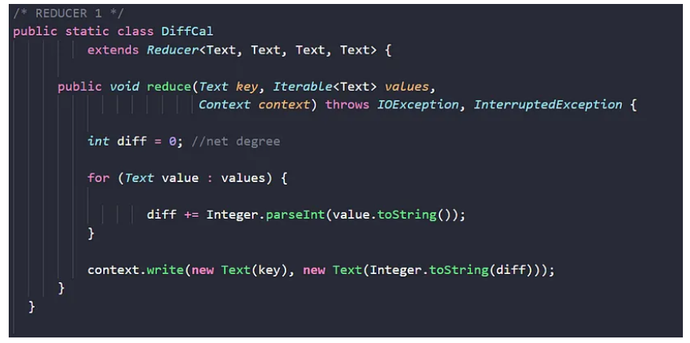
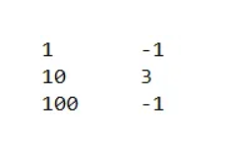
Multiple Map Reduce Jobs
Output of Job#1
Notes:
Map procedure for Job #1 simply loops through and breaks the .tsv input into 4 different values for each line: PickUpLocation ID, DropOffLocation ID, PassengerCount, and TotalFare.
Then, it writes each (PickUpLocation, inDegree) and (DropOffLocation, outDegree) as a key-value tuple that will be processed further by the Reduce procedure
what the Reduce procedure does is simply grouping by location ID and aggregate by summing up the second column to achieve the “diff”. Then it writes (Location ID, diff) as a key-value tuple.

Slide 19
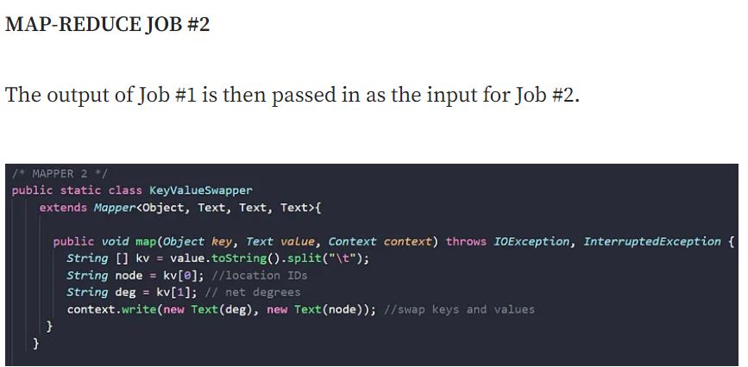
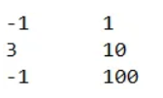
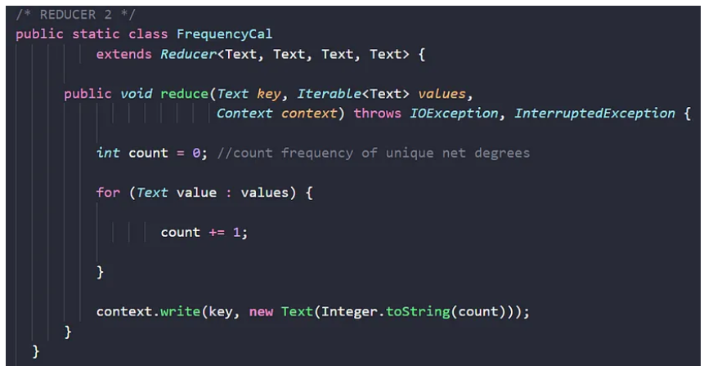
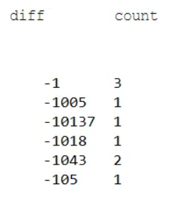
Multiple Map Reduce Jobs
Output of Mapper#2
Output of Job#2
Notes:
In order to group by “diff” to achieve the final output, the Map procedure of Job 2 needs to swap the input key-value pairs (Location ID, diff) into (diff, Location ID) because Reduce procedure groups by keys.
What happens here is that the Reduce procedure simply loops through the input and for each occurrence of a unique “diff”, its count increases by 1. At the end of the loop, it writes (diff, count) as key-value pair into the final output file:

Slide 20
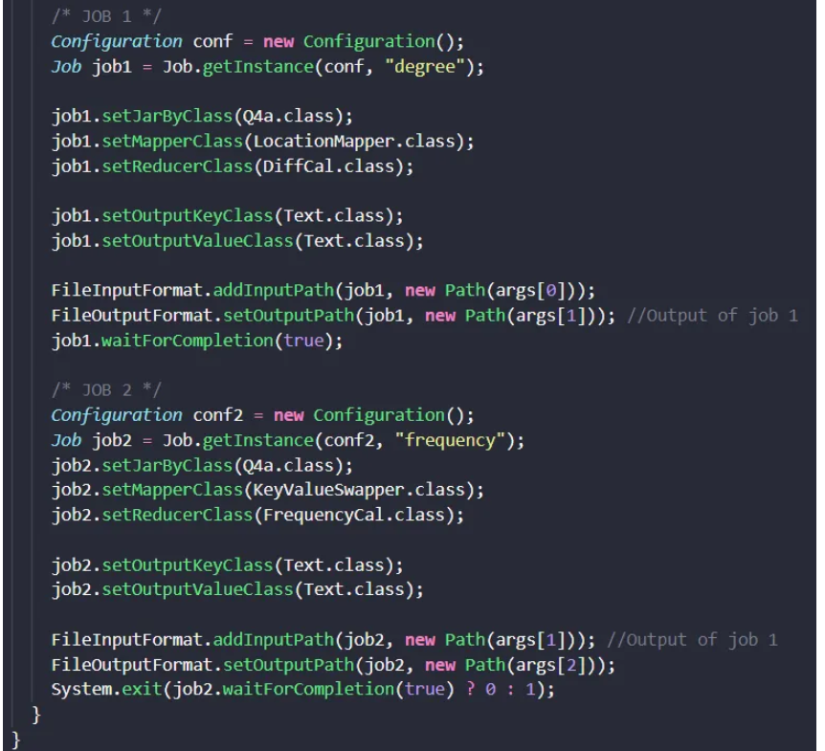
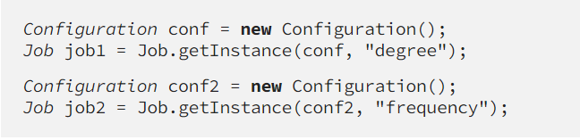
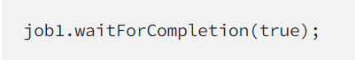
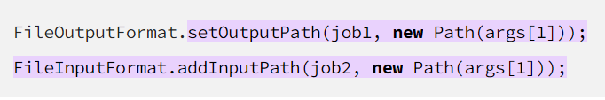
Chaining – Multiple Map Reduce Jobs
Chaining:
Notes:
Basically, the crux is to create two different configurations for the two jobs as “conf” and “conf2” where they also get two different instances.
Then using this command
We are ensuring that Job #2 can only be executed when Job #1 finishes with
But note that the system does not terminate here. For linking these two jobs, we do chaining; the output of Job #1 is the same as the input of Job #2:
So in this way, we get a chain of MapReduce jobs, and using this chaining mechanism we can chain more than 2 jobs.

Slide 21
Advantages of Map Reduce
Fault tolerance: It can handle failures without downtime due to multiple nodes.
Speed: It splits, shuffles, and reduces the unstructured data in a short time.
Cost-effective: Hadoop MapReduce has a scale-out feature that enables users to process or store the data in a cost-effective manner.
Scalability: It provides a highly scalable framework. MapReduce allows users to run applications from many nodes.
Parallel Processing: Here multiple job-parts of the same dataset can be processed in a parallel manner. This can reduce the task that can be taken to complete a task.
Notes:
These are some advantages of map reduce

Slide 22
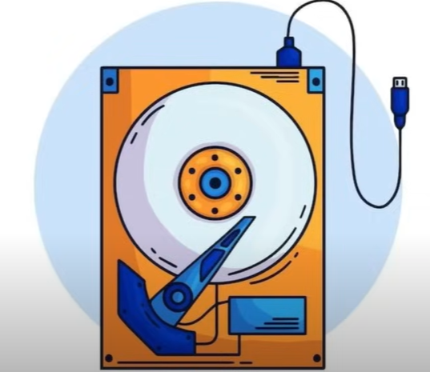
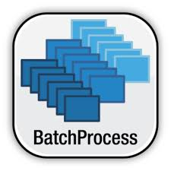
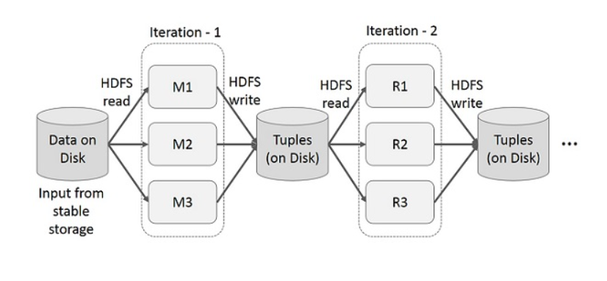

Hadoop Limitations (1)
Relied on storing data on Disk
Processes Data only in Batches
Which made things slower
Every time we run a job, it loads the data from disk, processes and stores the data back on disk.
We have to wait for one batch run to execute before submitting a new job.
Notes:
Although Hadoop is good at storing and processing large amount of data, there were some limitations:
This causes too much I/O dependency.
There emerges the need to process data faster and in real-time manner

Slide 23

Spark was developed as a research project by students at the California University in 2009
Apache Spark
Spark was created to address the limitations of Hadoop
Notes:
And that’s where Apache Spark comes in view.

Slide 24
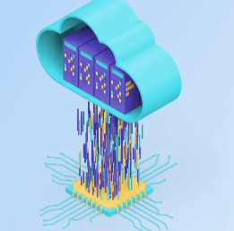

Apache Spark – RDDs
Works on the concept of RDDs
(Resilient Distributed Datasets)
RDDs are the backbone of Apache Spark
Allows Data to be stored In-Memory
Enables faster data access
Notes:
So, instead of loading and storing data again n again to and from the disk, Spark stores data in memory and by memory here we mean RAM.
And it works on the concept of RDDs.

Slide 25
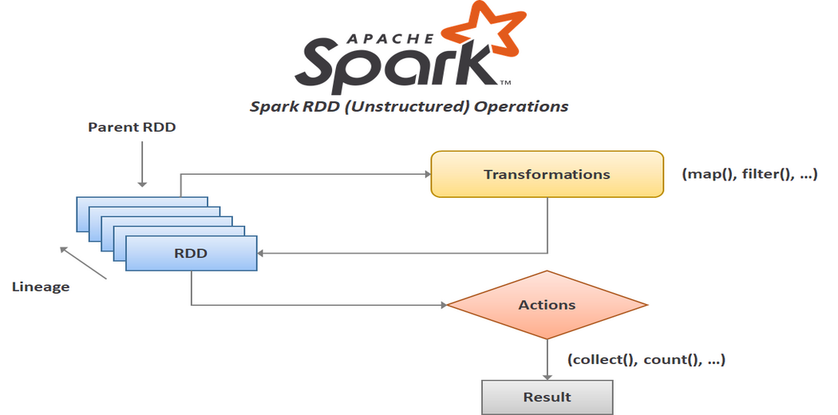
RDDs
RDDs (Resilient Distributed Datasets)
Notes:
Resilient Distributed Datasets (RDD) is a fundamental data structure of Spark. As the name suggests is a Resilient (Fault-tolerant) records of data that resides on multiple nodes.
It is an immutable (read-only) distributed collection of objects. Each dataset in RDD is divided into logical partitions, which may be computed on different nodes of the cluster. RDDs can contain any type of Python, Java, or Scala objects, including user-defined classes.
Spark makes use of the concept of RDDs to achieve faster and efficient MapReduce operations.
Most of the Hadoop applications spend more than 90% of the time doing HDFS read-write operations.
Recognizing this problem, researchers developed a specialized framework called Apache Spark. And the key idea is RDDs which supports in-memory processing computation.
This means, it stores the state of memory as an object across the jobs and the object is sharable between those jobs. Data sharing in memory is 10 to 100 times faster than network and Disk.

Slide 26
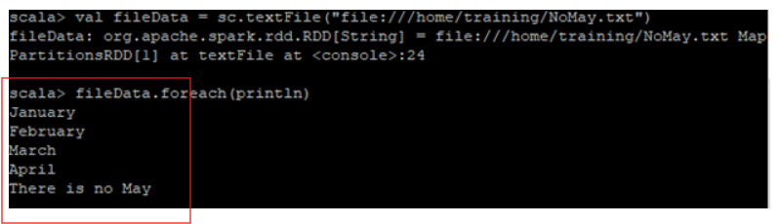
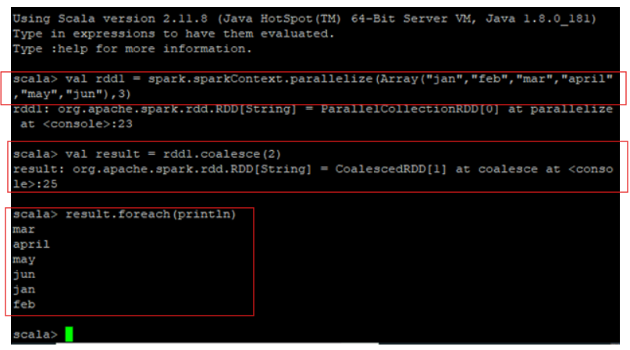
RDDs
RDDs (Resilient Distributed Datasets)
When Spark’s parallelize method is applied to a group of these elements, a new distributed dataset is created. This dataset is an RDD.
Notes:
We loaded a simple data of 6 elements
When Spark’s parallelize method is applied to a group of these elements, a new distributed dataset is created. This dataset is an RDD.
We are coalescing it because it was distributed and we wanted to show all of them together.
But you may see that the order is now changed, because spark distributed them to different chunks and when we tried to get them together they got in a different order.
RDDs perform iterative and interactive operations.

Slide 27
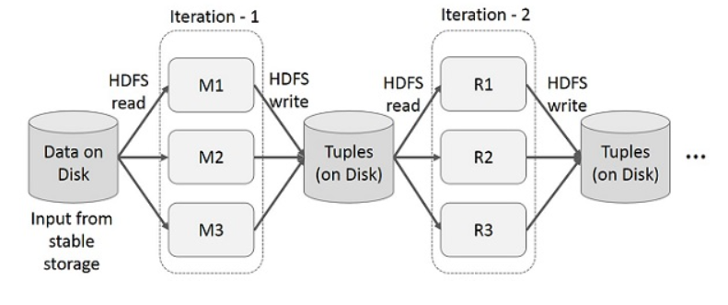
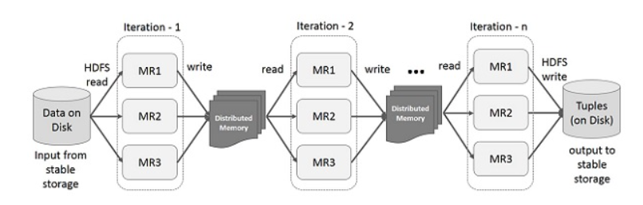
Iterative Operations – RDDs
RDDs (Resilient Distributed Datasets)
MapReduce
Notes:
It will store intermediate results in a distributed memory instead of Stable storage (Disk) unlike mapreduce that uses disk, and make the system faster.
Note − If the Distributed memory (RAM) is not sufficient to store intermediate results (State of the JOB), then it will store those results on the disk.

Slide 28
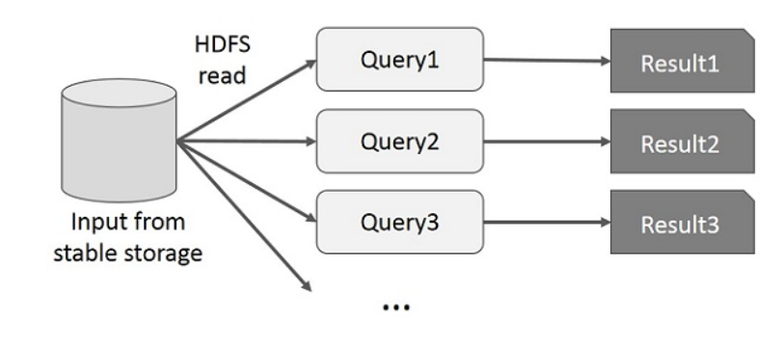
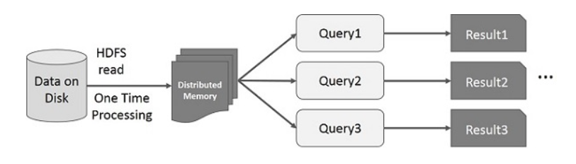
Interactive Operations – RDDs
RDDs (Resilient Distributed Datasets)
MapReduce
Notes:
If different queries are run on the same set of data repeatedly, this particular data can be kept in memory for better execution times.
Unlike MapReduce that keeps querying from the stable storage and hence increases the cost.

Slide 29
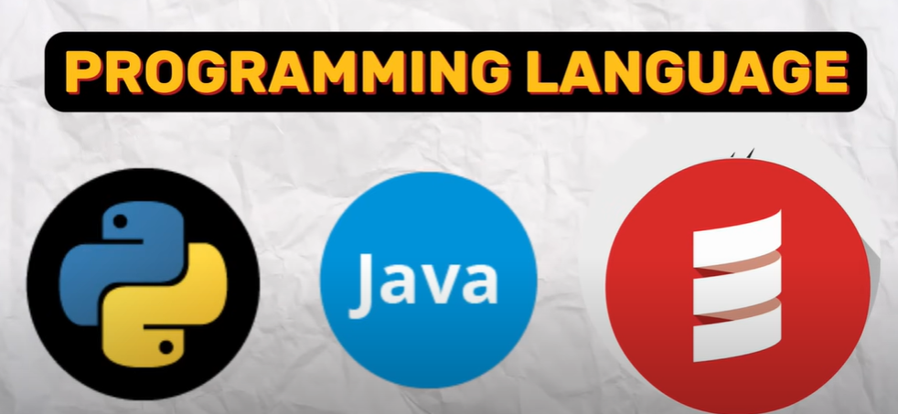
Spark compatibility with Languages
Notes:
Spark also gave the privilege to write code in various programming languages, python java scala, so we can choose the language of our choice and process large amount of data.

Slide 30
Spark & Hadoop
This RDD architecture and In-Memory processing makes
Spark 100x Faster than Hadoop
Notes:
Spark became very famous in no time because:
It was fast
It could handle a lot of data and process it efficiently
And above all we can run spark even in a jupyter notebook and it does not need heavy configurations and setup.

Slide 31
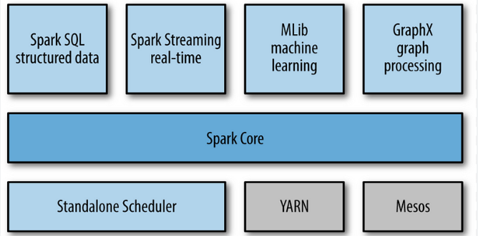
Components of Spark

Slide 32

Spark Core
Helps with processing data across multiple computers
It makes sure everything works efficiently and smoothly
Notes:
This is the main module of spark

Slide 33

Spark SQL
Allows writing SQL queries directly on your data through Spark

Slide 34

Spark Streaming
Helps you persist the real time data that you see in Google maps or Uber

Slide 35

Spark MLlib
Helps you train the large scale Machine Learning models on Big Data
Notes:
And all these tools made Spark a really powerful tool for processing and analyzing Big Data

Slide 36

Spark Architecture
Since Spark distributes processing over different machines;
To coordinate work on all of the different machine we need a proper framework
Cluster Manager will grant resources to applications to complete the work
Notes:
When ever we run anything it goes to the cluster manager
Any job in spark is called a spark application.
As there were components of spark , sql, mllib etc, there are 2 important components for spark application as well
And these are the driver and executor processes
They both report to cluster manager

Slide 37



Spark Application – Components
Driver Process: Like a boss
Executor Processes: Like Workers
Driver keeps track of all the information about Apache Spark Applications
It responds to the commands and inputs from the user
Executors just execute the tasks
Notes:
Driver analyses the work that needs to be done
Divides the tasks among the executors.
Driver keeps track of all the information about Apache Spark Applications
It responds to the commands and inputs from the user
Executors just execute the tasks

Slide 38

Spark Application – Components
Driver divides the work into smaller tasks and assigns them to the executors and allocates the right resources based on the inputs we provide
Executor Processes are the ones that actually does some work and executes the task assigned by driver process
Notes:
Driver process is the heart of Apache Spark because it is responsible for getting the work done
Executors report back to the driver process, the progress and the results of the work done.

Slide 39


Spark Session
Creating Spark Session is the first thing that we do when working in Spark
We can create this session in any of the three languages
Notes:
Creating Spark Session is the first thing that we do when working in Spark
Its like we are making the connection with the cluster manager
We can create this session in any of the three languages
And it gets us connected with the cluster manager.

Slide 40


Spark DataFrame Distribution
Spark distributes the DataFrames among multiple computers
To make sure data is processed parallely we need to divide data into different chunks. This process is called partitioning.
All this is done using “Transformations”, which are instructions that tell Spark how to modify this data to get the desired results.
Notes:
To make sure data is processed in a parallel manner we need to divide data into different chunks. This process is called partitioning
All this is done using “Transformations”, which are instructions that tell Spark how to modify this data to get the desired results

Slide 41

Spark Transformations & Actions
Spark provides a list of Actions to execute our transformation blocks
Notes:
Transformations are functions that accept the existing RDDs as input and output one or more RDDs. However, the data in the existing RDD in Spark does not change as it is immutable.
While the partitioning is done on the basis of transformations
Transformations are executed using actions.
Actions in Spark are functions that return the end result of RDD computations. It uses a lineage graph to load data onto the RDD in a particular order. After all of the transformations are done, actions return the final result to the Spark Driver.
And these actions are responsible for the lazy evaluations in spark.

Slide 42


Spark Lazy Evaluations
This allows spark to create a flow (DAG) to process the code Efficiently
Spark does not gives the results or processes the input as soon as you submit
Infact it will wait until you write your complete code and then it will generate plan to execute the code you have written
Notes:
DAG = Directed Acyclic Graph
It simply means you write a transformation in a cell and run it, it wont perform anything
Untill you don’t write an action and run it, it will wait for you.
And as soon as you run the desired action, it will create an execution plan like this DAG and will run all those transformations that you ran above
It helps in saving memory by this managed workflow approach

Slide 43
Spark Working – Demo
Pandas Vs. Spark
We have got the same Word Count problem at hand but this time with Spark or Pandas
We will create a big amount of data.
Input:
A huge dataframe
Output:
Words and their Counts

Slide 44


Spark Vs Pandas
Pandas Vs. Spark in smaller data
Notes:
We have a list of 3 strings, and we multiplied it with 100 thousands to create a list of 300 thousands strings
Splitting words and exploding to make it a dataframe of 900 thousand words (instead of 300 thousands strings we have 900 thousand words)
This shows that as long as the data fits into the memory, nothing is better than pandas
And spark performs worse than pandas because it spends time in creating rdds and processing them.

Slide 45


Spark Vs Pandas
Pandas Vs. Spark when data is huge
Notes:
And here; We have a list of 3 strings, and we multiplied it with 100 million to create a list of 300 million strings
We performed the same steps, but we got a memory error, pandas could not load such a huge data into the memory.
That’s where spark shines. This is the power of Spark, it can process such a huge data (900 million records) in that same memory that pandas failed to process in.

Slide 46

Spark Vs Hadoop
Spark
The same mapper function
Terminal Commands
Hadoop
The same reducer function
Hence; Spark is faster than Hadoop
Notes:
This is the same mapper and reducer functions, they are performing to get the solution of the same word count problem,
Hadoop was able to get it done but took a lot more time than spark due to manual interventions of writing commands and working through terminal/std. output

Slide 47
Hadoop vs. Spark
Key differences:
Batch processing vs. real-time processing.
Complementary roles:
Hadoop for storage and batch processing
Spark for real-time processing.
Performance comparison.
Notes:
While Hadoop and Spark are often compared, they serve complementary purposes.
Hadoop excels in batch processing and storage,
whereas Spark shines in real-time data processing and iterative computations.
Performance-wise, Spark's in-memory processing can be much faster than Hadoop’s disk-based approach.

Slide 48

Hadoop + Spark Real Time Architecture
Notes:
However, Hadoop’s HDFS is often used as the underlying storage system for Spark, combining the strengths of both frameworks for a more robust big data solution.

Slide 49
Unlock new levels of Performance, Scalability, and Efficiency
Low-level parallel processing architectures
GPUs (Graphics Processing Unit)
TPUs (Tensor Processing Unit)
Utilizing GPU Acceleration with Spark/Hadoop
Spark: Rapids.ai and GPU-aware scheduling
Hadoop: cuDF and cuML
Integrating TPUs with Spark/Hadoop
No direct support for TPUs in both Spark and Hadoop
TensorFlow,
GCP → Dataproc, AI Platform.
Benefits: Performance Improvement, Scalability, Cost Efficiency, Enhanced Capabilities
Notes:
To further significantly enhance the performance and scalability of data processing and machine learning tasks.
We must consider integrating Spark and Hadoop with low-level parallel processing architectures like GPUs and TPUs.
Apache Spark provides support for GPU acceleration through libraries like Rapids.ai and GPU-aware scheduling. And Hadoop can benefit from GPU acceleration by integrating GPU-enabled libraries like cuDF for data processing and cuML for machine learning tasks.
While there isn't direct support for TPUs in Spark or Hadoop, you can still leverage TPUs for machine learning tasks by integrating them with frameworks like TensorFlow, which offers TPU support. You can train deep learning models using TensorFlow on TPUs and then integrate them with Spark/Hadoop for data preprocessing, feature engineering, and inference tasks.
Alternatively, you can use TPU Pods on Google Cloud Platform (GCP) and leverage services like Dataproc (for Hadoop/Spark) and AI Platform (for TensorFlow) to seamlessly integrate TPU-based machine learning workflows with distributed data processing.

